Slide 1
Mentally Healthy Schools
Creating school belonging: Staff presentation

Slide 2
Act Belong Commit message
The feeling of deep connection with social groups, physical places, and experiences.

Slide 3
Mentally Healthy Schools program aims
The feeling of deep connection with social groups, physical places, and experiences.

Slide 4
Whole-school belonging
It’s important for schools to focus on whole-school belonging strategies, to ensure the school community feels connected in the classroom, at school events and activities and welcome to approach school admin.
In this PowerPoint, Act Belong Commit has provided whole-school belonging strategies.

Slide 5
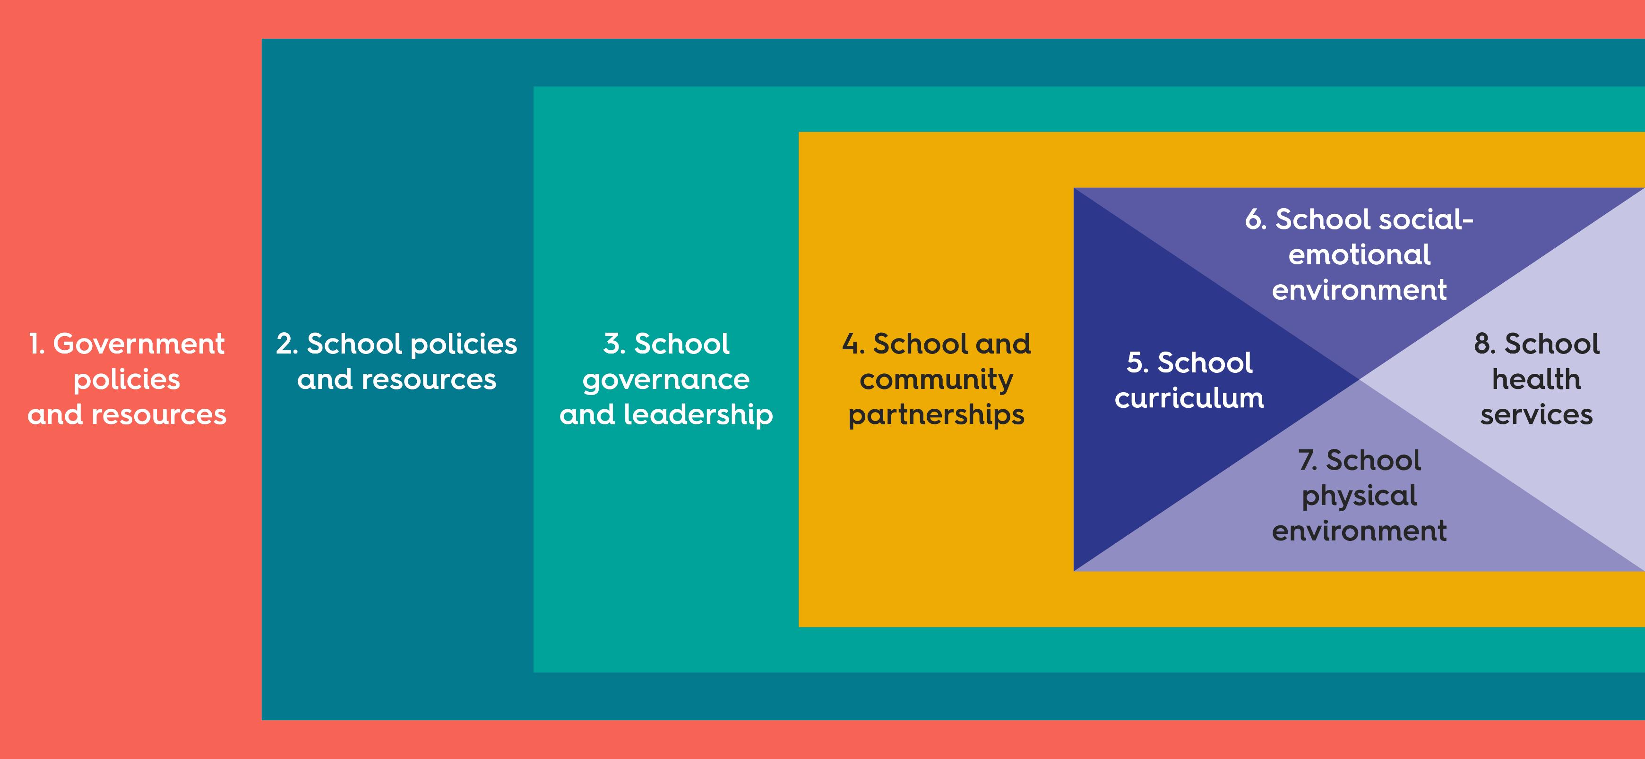
Whole-school approach:
The Health Promoting Schools Framework
The feeling of deep connection with social groups, physical places, and experiences.
World Health Organization. (2021). Part 1: What is a health-promoting school? https://www.who.int/multi-media/details/what-is-a-health-promoting-school

Slide 6
Whole-school approach:
The Health Promoting Schools Framework
World Health Organization. (2021). Part 2: What is a health-promoting school? https://www.who.int/multi-media/details/answer-what-is-a-health-promoting-school

Slide 7
Belonging defined
The feeling of deep connection with social groups, physical places, and experiences.
Allen, K. A., Kern, M. L., Rozek, C. S., McInereney, D., & Slavich, G. M. (2021). Belonging: A Review of Conceptual Issues, an Integrative Framework, and Directions for Future Research. Australian journal of psychology, 73(1), 87–102. https://doi.org/10.1080/00049530.2021.1883409

Slide 8
Student belonging
The extent to which students feel personally accepted, respected, included, and supported by others in the school social environment.
Goodenow C., and Grady K. E. (1993). The Relationship of School Belonging and Friends’ Values to Academic
Motivation Among Urban Adolescent Students. The Journal of Experimental Education, 62(1), 60–71.

Slide 9
School belonging
School belonging contributes to positive relationships between staff, students and the wider community and helps creates a positive school culture.

Slide 10
Benefits of belonging
Student benefits:
Students feel confident to be themselves.
Increased engagement, motivation and positive attitudes towards learning.
Enhances emotional resilience.
Higher attendance rates and academic outcomes.
Contributes to the development of social skills.
Leads to enhanced relationships with school staff and peers.
Students feel supported to seek help.
Increased school enjoyment.

Slide 11
Benefits of belonging
Benefits for staff and the school:
Staff feel valued, supported and respected.
Staff feel more connected to colleagues and to the school.
Leads to positive school culture and environment.
Leads to positive relationships with students, families and the community.
Families and the community feel welcome and connected to the school.
Reduction in bullying and exclusion of students.
Improves communication between staff and the community.
Promotes staff retention and helps to reduce burn out.

Slide 12
Strategies for belonging*
Encourage positive relationships between teachers and students
The school to provide teachers the time to be available for student personal support.
Teachers to demonstrate fair and equitable practices in the classroom at all times.
Teachers model respectful behaviours towards each other and students.
Class expectations developed in collaboration with students.
Student-led groups are available to provide opportunities for student voices/representation.
School staff to run clubs such as breakfast club, chess club, STEM club to allow opportunities for students to get to know them (see the list of student clubs and groups in the factsheet).
Ensure teachers are using inclusive language consistently.
*choose the strategies that will work for your school context

Slide 13
Strategies for belonging
Encourage a positive whole-school peer culture of belonging
Enable multiple opportunities for students to connect - Offer extracurricular activities.
Host school sanctioned activities that foster social connectedness and school bonding e.g. sports days, house activities etc. Encourage students to engage in these activities and ensure staff and parents model participatory behaviours.
Create peer support networks to enable students to be academically supportive of each other.
Ensure expectations for inclusion and kindness are taught from Term 1 each year.
Promote the school’s approach to fostering an environment that creates a sense of belonging.
Implement and use a Buddy Bench system.

Slide 14
Strategies for belonging
Encourage academic motivation and engagement through belonging
Teachers to encourage students to have high expectations of their academic ability.
Teachers utilise flexible teaching methods.
Learning activities are varied and reflect different learning styles.
Teachers to outline benefits and purpose of learning activities (Success Criteria and Learning Intentions).
Learning activities and content relate to real world experiences.
Encourage goal setting behaviours and outline the benefits of achieving goals.
Teachers to ensure learning is student-directed and strength-based.
Skills relating to self-regulation are taught and used regularly.

Slide 15
Strategies for belonging
Mental health promotion and proactivity
Implement health promotion program and activities using a whole school approach (including Act Belong Commit, Mind Matters and Be You).
Ensure staff are provided adequate training on mental wellbeing and mental health prevention.
Develop a student and/or staff wellbeing committee to provide mentally healthy activities that promote belonging and school connectedness.
Encourage help-seeking behaviours across the school. Highlight key staff members to seek personal support where needed (chaplain, counsellor etc.)
School leadership are responsive to the mental wellbeing needs of students and staff.

Slide 16
Strategies for belonging
Encourage personal empowerment in mental wellbeing
Educate students on their role in fostering their own sense of school belonging (see Act Belong Commit classroom belonging activities).
Facilitate activities that encourage students to identify key strengths and provide opportunities to utilise strengths within classroom and school activities.
Teach students about the benefits of having a positive mindset.
Use the Growth Mindset in the school and the classroom to promote positive mindsets.
Encourage mindfulness, including breathing and gratitude practices.

Slide 17
Strategies for belonging
Staff belonging strategies
Staff are given opportunities to build positive culture through regular activities or events.
Weekly staff activities (such as morning yoga, run club, book club etc.)
Leadership to provide team-building activities, in addition to school planning and review days.
Encourage staff shout outs and read them out at regular meetings.
Colleagues and leadership to write thank you notes to express appreciation for school staff.
Encourage random acts of kindness between staff (see Staff Belonging Resources).
Encourage staff to complete the Act Belong Commit Mental Wellbeing Quiz.
Leadership to regularly check-in with staff to find out how they are going and if they need any additional support.

Slide 18
Strategies for belonging
Staff professional development
Schools provide teachers the opportunity for professional development through mentoring programs that are aimed at fostering student belonging.
Ensure teachers receive professional development on inclusive language and inclusive practices, including strength-based teaching.

Slide 19
Strategies for belonging
Encourage family and community involvement
Provide opportunities for families to be involved in meaningful ways e.g. family events, parent- led committees, open nights and parent education.
Promote strong communications to families through newsletters, information nights and email.
Disseminate information to parents that specifically provides information and strategies for supporting their child’s learning and sense of belonging to the school.
Offer courses/information nights that promote ways to foster positive parent/carer-child relationships and positive communication skills.

Slide 20
Student clubs and groups
Act Belong Commit strongly encourages schools to provide students the opportunity to join clubs based on their interests, where possible.
Participation in clubs can lead to feelings of safety, purpose and belonging and can also promote connections between like-minded students.
It’s important to involve students in the process of setting up and managing clubs, this can improve their sense of empowerment and help them feel a sense of ownership and pride over the club.

Slide 21
Student clubs and groups
Ideas for student clubs/groups
Anime club
Art/craft clubs
Breakfast club
Bush wardens
Chess club
Cooking club
Debate club
Drama club
Enviroclub
Film club
Garden club
History club
IT club
Language club
Lego club
LGBTQIA+ club
Maths club
Multicultural club
Music club
Poetry club
Reading club
Robotics club
Run club
School Council
Social club
STEM club
Student event committee
Student wellbeing group
Walk/ride to school team
Yoga club

Slide 22
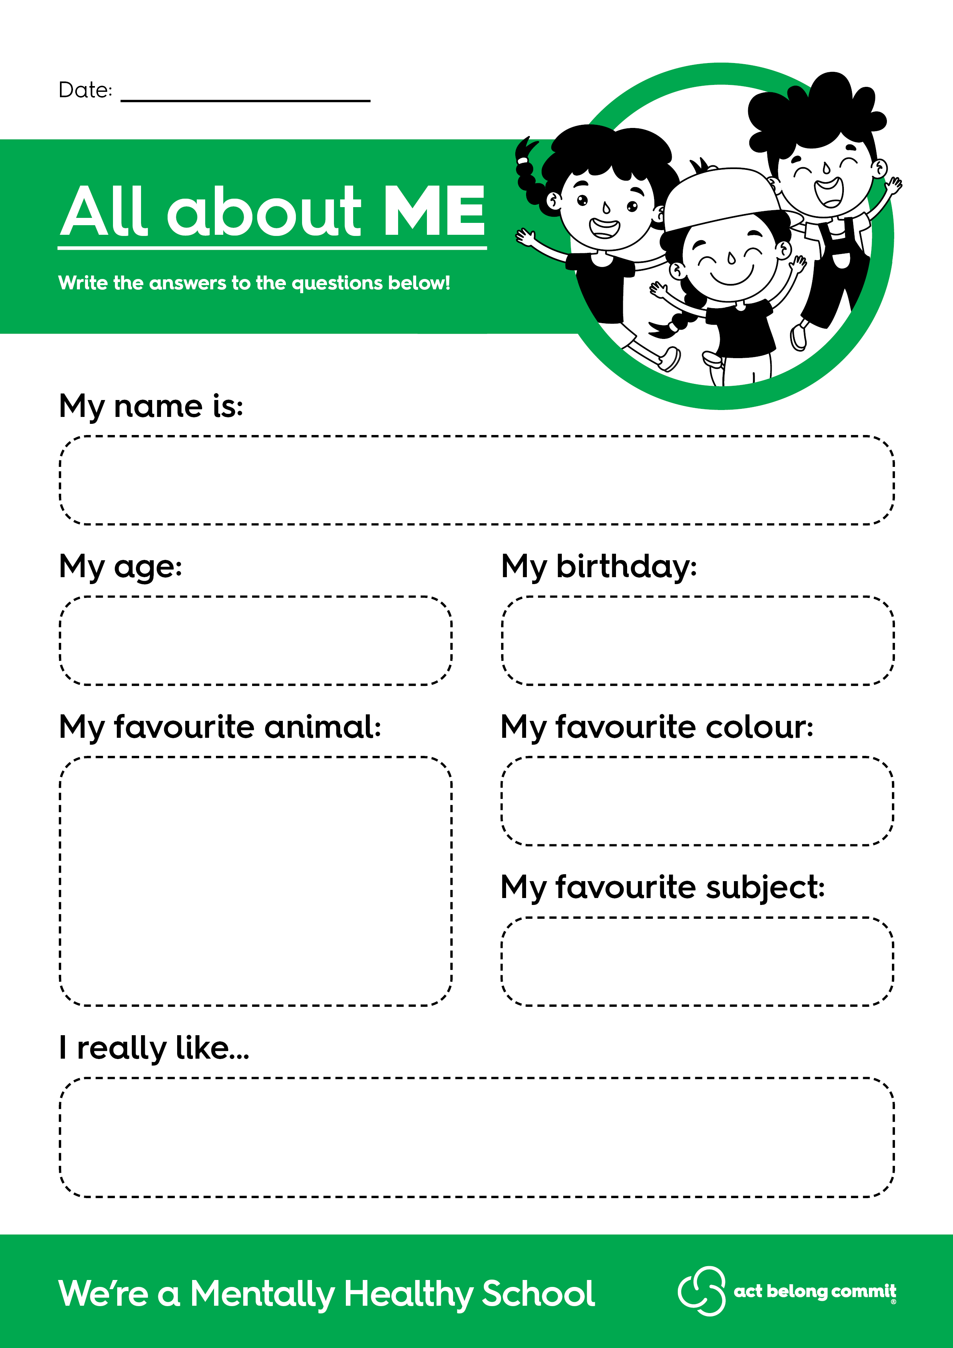
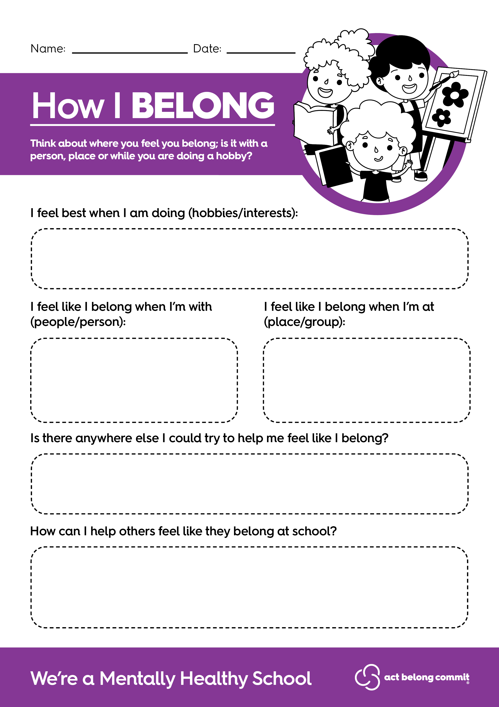
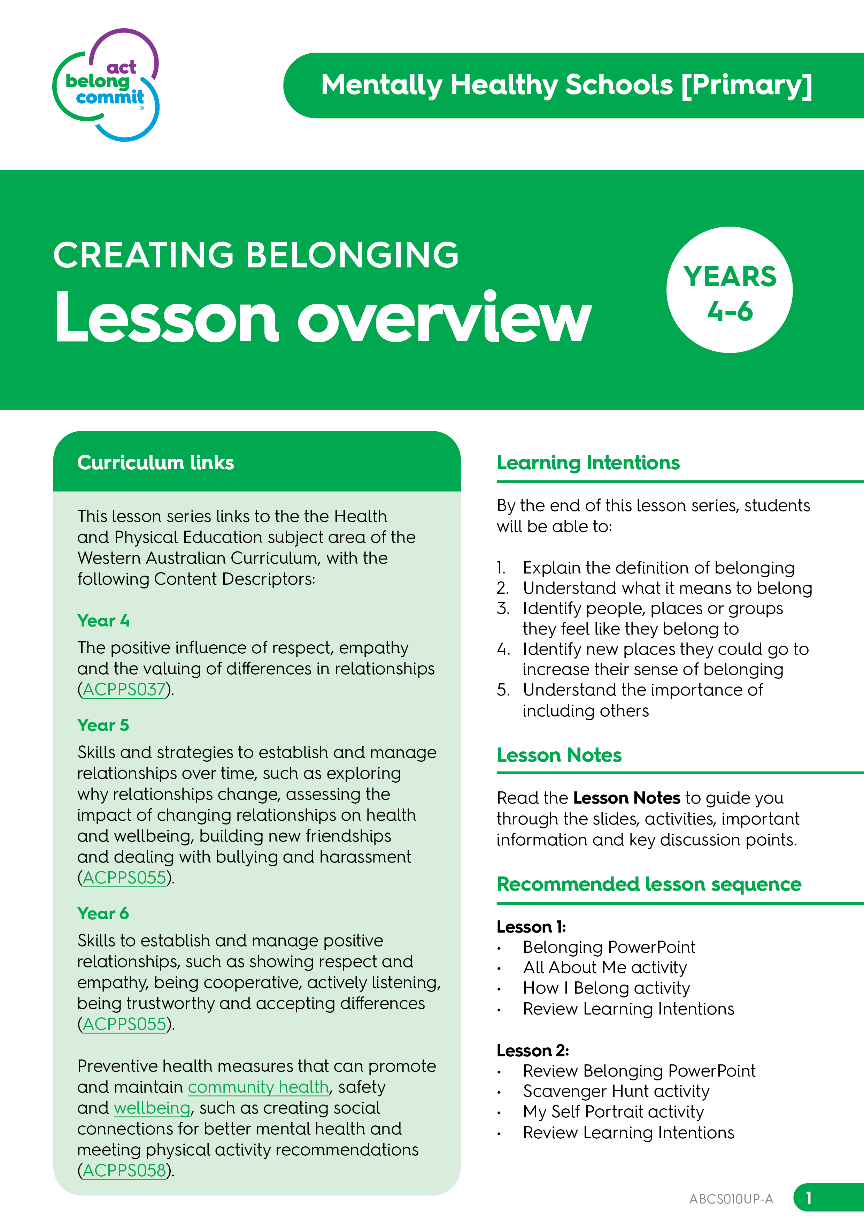
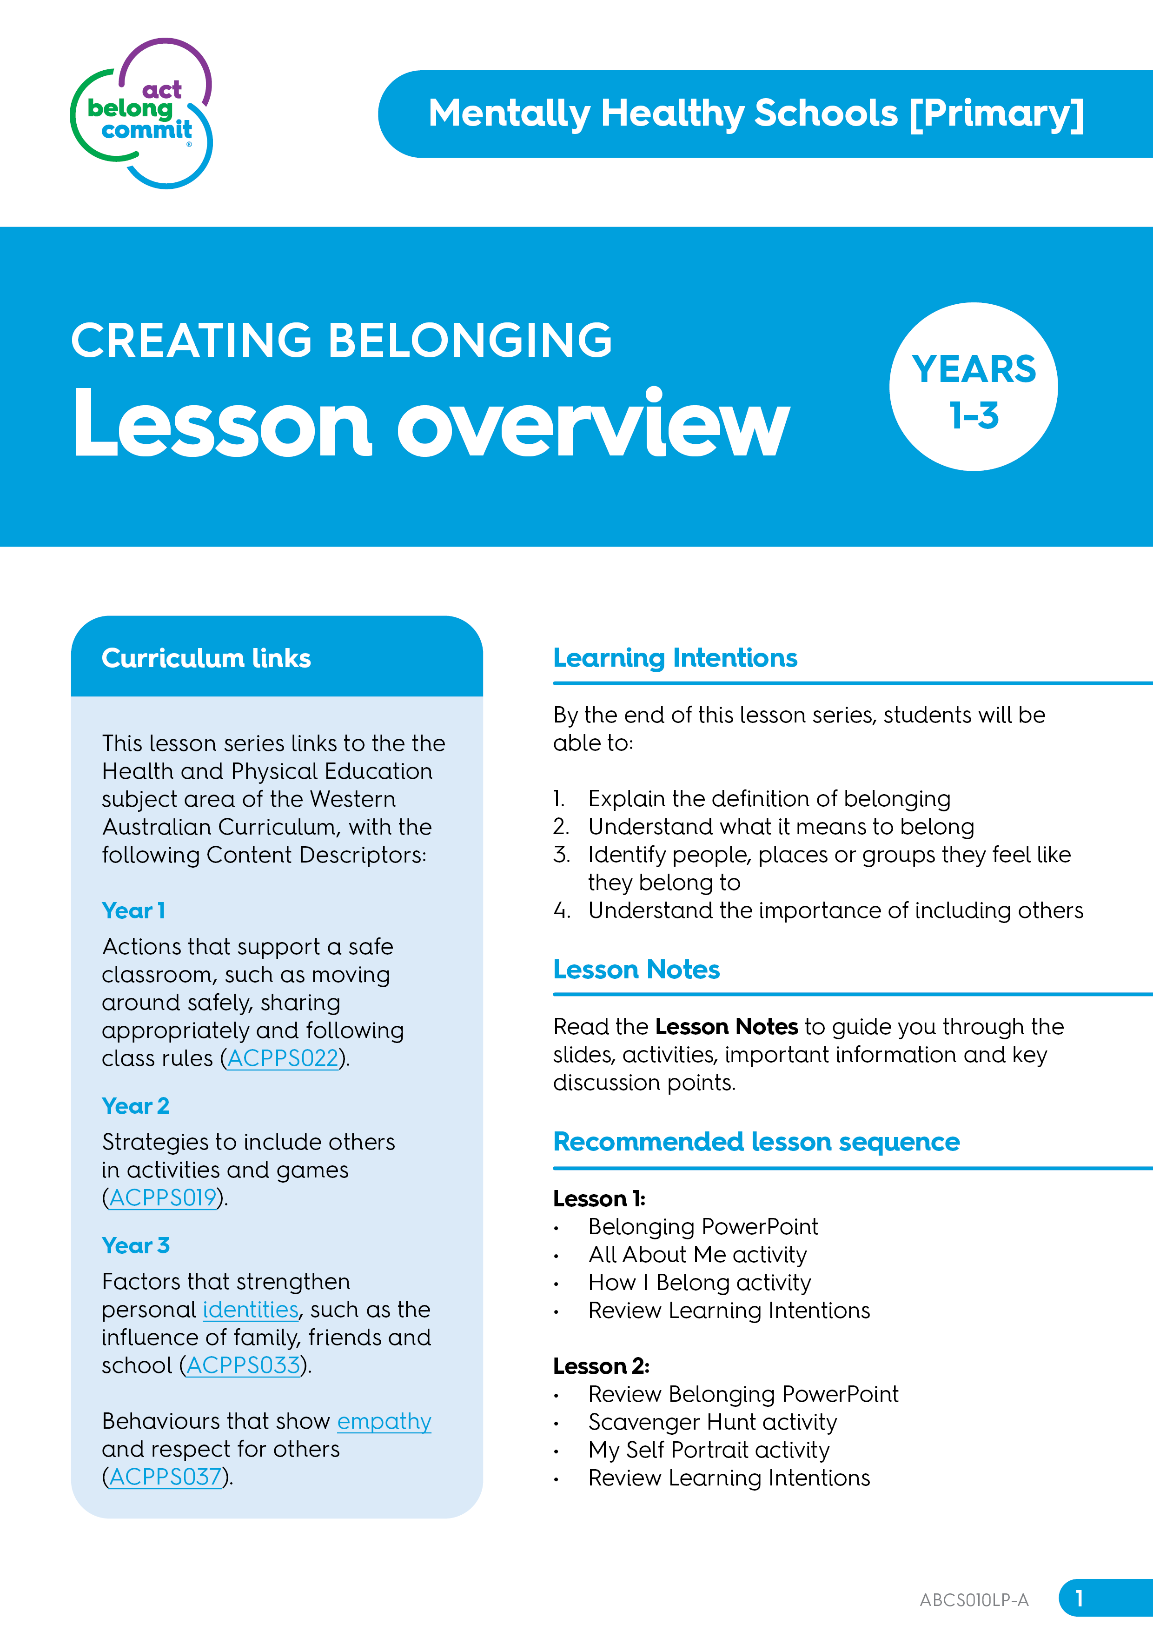
Mentally Healthy Schools resources
To support school belonging
Curriculum-linked Classroom Activities and PowerPoint on how to create belonging.
School Belonging Factsheet: Includes evidence-based information and a list of practical strategies for schools to implement to enhance belonging.
Staff Wellbeing Resources to enhance staff connectedness and belonging.

Slide 23
Mentally Healthy Schools resources
To support staff belonging
Act Belong Commit have developed the following resources for schools to use to encourage acts of kindness leading to enhanced staff belonging and improved school culture:
Staff Thank You Notes Encourage staff to use Thank You Notes to thank colleagues for their support or hard work at the school.

Slide 24
Mentally Healthy Schools resources
To support staff belonging
Staff Shout Outs Ensure staff are acknowledged for their positive contributions to the school by encouraging staff to complete a Staff Shout Out slip and read out completed Staff Shout Outs in regular meetings.
Random Act of Kindness: Fill Someone’s Cup! Use this resource to encourage staff to spread kindness by making other staff a hot drink when they might need their cup filled up!

Slide 25
Find these resources on the School Portal
www.actbelongcommit.org.au/school-portal
Password: PurpleGreenBlue

Slide 26
Act Belong Commit can support you!
If you need support in implementing any belonging or other mental wellbeing strategies, please reach out.
Email actbelongcommit@curtin.edu.au

