Slide 1


Creating Mentally Healthy Schools

Slide 2

We acknowledge the traditional owners of the land, the Whadjuk Noongar people and pay our respects to elders past and present.

Slide 3
Today’s Training
About mental wellbeing
Improving and maintaining mental wellbeing
Ways to Act Belong Commit in your school
Health Promoting Schools Framework
How we can support you to be a Mentally Healthy School
  Resources
  Environment
  Partnerships
  Getting started

Slide 4
Facts about mental wellbeing
Mental health is a state of wellbeing (where a person realises their potential and can cope with life’s normal stresses),
without mental health there is no health,
mental health differs depending on personal circumstances (SES, genetics and lifestyle factors).
WHO. (2018). Mental health: strengthening out response. Retrieved from: https://www.who.int/news-room/fact-sheets/detail/mental-health-strengthening-our-response

Slide 5
How can mental wellbeing be improved and maintained?

Slide 6
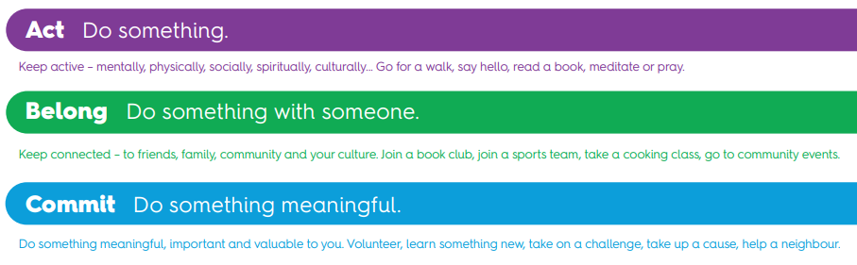
Foundations for mental health and wellbeing

Slide 7


The Strategic Platform

Slide 8
Opportunities to Act
Opportunity | School based examples
Culturally active | Acknowledge and celebrate cultures as a school (e.g. NAIDOC week, Chinese New Year, Diwali, etc. (links to cross-curriculum priorities) Ensure lessons are culturally diverse Celebrate and learn about student differences Translating documents for culturally and linguistically diverse families
Socially active | Develop clubs or groups within the school tailored to different students’ interests Ensure the school holds events throughout the year to encourage social connection (e.g. markets, fundraisers, inviting other community organisations) Promote clubs or groups within your community for students to join
Mentally active | Colouring or sensory corner in classrooms Sensory tents at large events Ensure books and games are available to students during breaks to encourage mental activity Provide opportunities for students to participate in art and music
Spiritually active | Allowing space for students to pray Understanding and respecting student’s spiritual and religious beliefs Regular school or class meditation
Physically active | Morning physical activity or yoga sessions Equipment available to students at lunch time to encourage physical activity Promote school sporting groups

Slide 9




Benefits of this:
Greater physical fitness and health
Improved
psychological wellbeing
Positive self-esteem
Reduced stress levels

Slide 10
Opportunities to Belong
Opportunity | School based examples
Join a club | Develop clubs or groups within the school tailored to different students’ interests (e.g., chess, dance, book club, maths, social) Develop school sporting groups at lunch or after school Promote clubs or groups within your community for students to join
Student/staff belonging | Implement health promotion programs such as Act Belong Commit, Be You, Mind Matters, etc. Teachers showing support and interest in students' lives/education Encourage help seeking behaviours (reduce stigma) Acknowledge students' strengths and giving them opportunities to use strengths Practicing gratitude
Classroom belonging | Greeting each student in the morning Classroom routines Classroom yarning circles (to explore this week's feelings) Strength-based teaching approaches Acknowledging positive behaviours Making parents/caregivers welcome in the classroom
School belonging | Regular school events and activities Parents/caregivers encouraged to be involved at school Implement a buddy or peer support program Highlight key staff members that may be needed for personal support

Slide 11




Benefits of this:
Increased
positive feelings
Higher academic
performance
Greater coping ability
Less risk-taking behaviours

Slide 12
Opportunities to Commit
Opportunity | School based examples
Commit to a goal or an activity | Raise money for the school or charity Develop and maintain a school vege garden Paint a school mural
Volunteer | Pick up rubbish at the local beach Parent volunteers
Develop an Act Belong Committee | Ask students, staff or parents to be champions in the school and develop ideas for mental wellbeing activities
Get involved in the community | Attend community events Donate old clothes or toys to the op shop
Fundraise/donate | Fundraise as a school or class for local charity groups Ask students to bring a tin of food for a food relief organisation
Random Acts of Kindness | Let somebody else go first Share something with another student Make another teacher a coffee/tea Teacher to reinforce kindness in the classroom

Slide 13


Benefits of this:
Greater life satisfaction
Reduced stress levels
Increased immune function

Slide 14
The Mentally Healthy Schools Program aims to…
Increase and maintain awareness
Increase and maintain the individual awareness and understanding of students, staff and parents that they can and should do things to keep mentally healthy.
Increase and reinforce participation
Increase and reinforce participation in mentally healthy activities amongst students, school staff and parents.
Foster partnerships
Foster partnerships between schools and their wider communities.
Reduce stigma
Reduce stigma around mental illness and increase openness to discuss mental health in the school community.

Slide 15
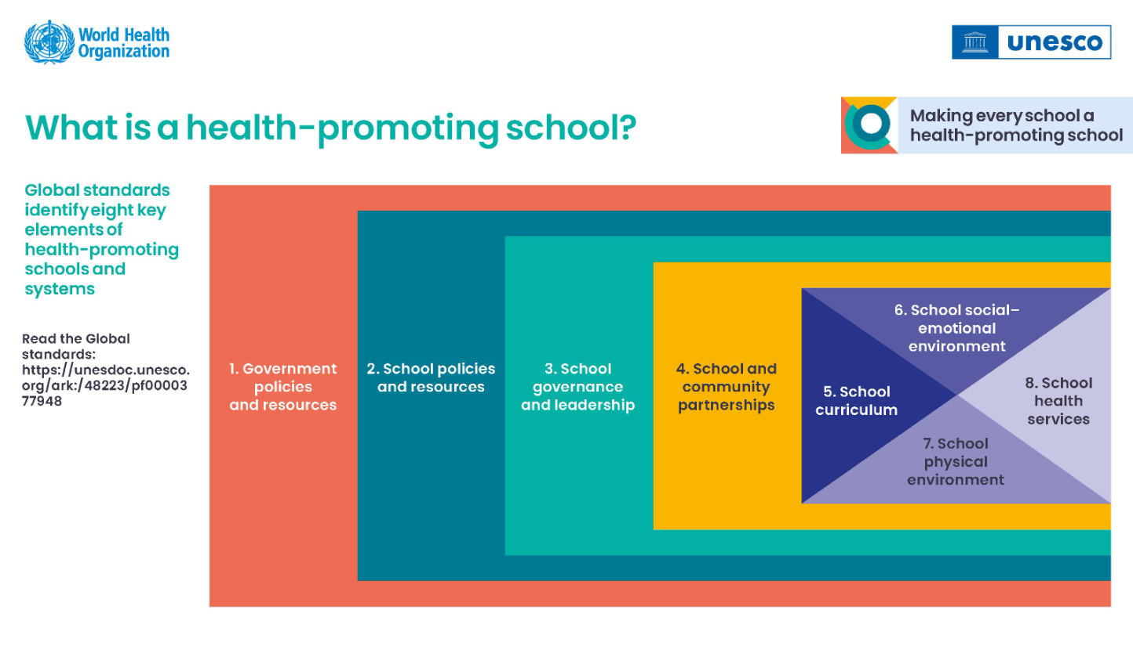
Whole School Approach

Slide 16
How can we support you?
Policy
Mental health inclusion in policy
Mental Health Policy
Health Policy
Business Plan
eg. ‘Increase and maintain the individual awareness and understanding of students, staff and parents that they can and should do things to keep mentally healthy.’
Resources
Evidence-based research
Signage
Posters
Social media assets

Slide 17
How can we support you?
Governance &
Leadership
Evidenced-based information for leadership team
Provide training for school and leadership staff
Provide a framework for school mental wellbeing

Slide 18
How can we support you?
Partnerships
  Connect and partner with local organisations
  Check ABC website for local partners
  Use ABC Activity Finder to find local events/activities
  Connect online through social media
Other partnerships/ initiatives:
  R U Ok Day
  Mental Health Week
  International Day Against Bullying and Violence

Slide 19
How can we support you?
School curriculum
  Curriculum-linked activities and ideas
  Develop co-branded curriculum-linked resources

Slide 20
How can we support you?
Social-emotional Environment
  Encourage conversations around mental health
  Reduce stigma around mental health
  Enhance opportunities to belong
  Provide ideas for students to participate in activities that benefit their mental wellbeing
  Equip students and staff with understanding of how to maintain and improve mental wellbeing

Slide 21
How can we support you?
Physical Environment
  Setting up spaces for students to take time out (e.g., calm corner, sensory room)
  Providing activities for students to participate in (chess club, maths club, sporting club, etc.)
  Promoting school activities that benefit mental health
  Link/educate on activities and benefits to mental wellbeing
  Message visibility - Act Belong Commit signage, posters displays
  Naming events/activities “Act Belong Commit Athletics Carnival”, “Mentally Healthy Maths Club”, etc.

Slide 22
How can we support you?
School health services
  Working with school psychologists, nurses, chaplains, etc.
  Providing resources for health services
  Providing ongoing support for health services

Slide 23
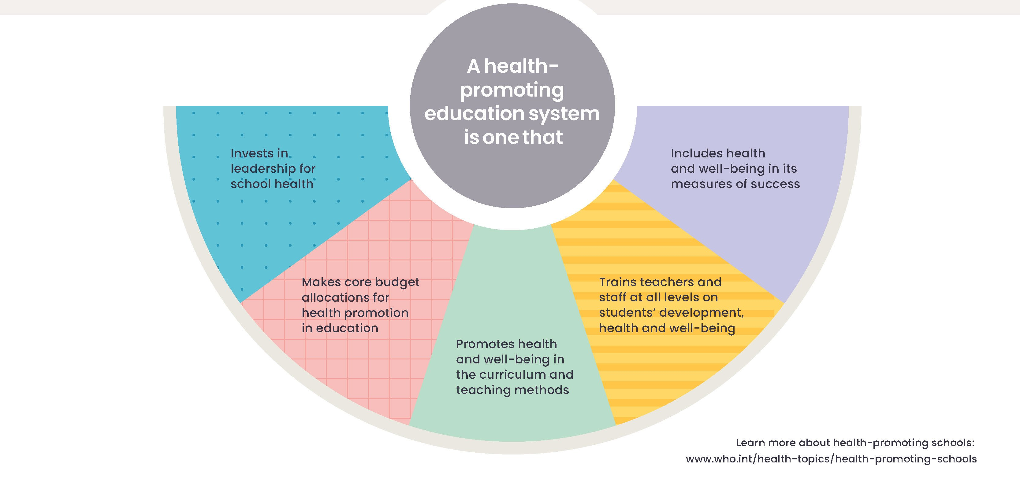

Slide 24
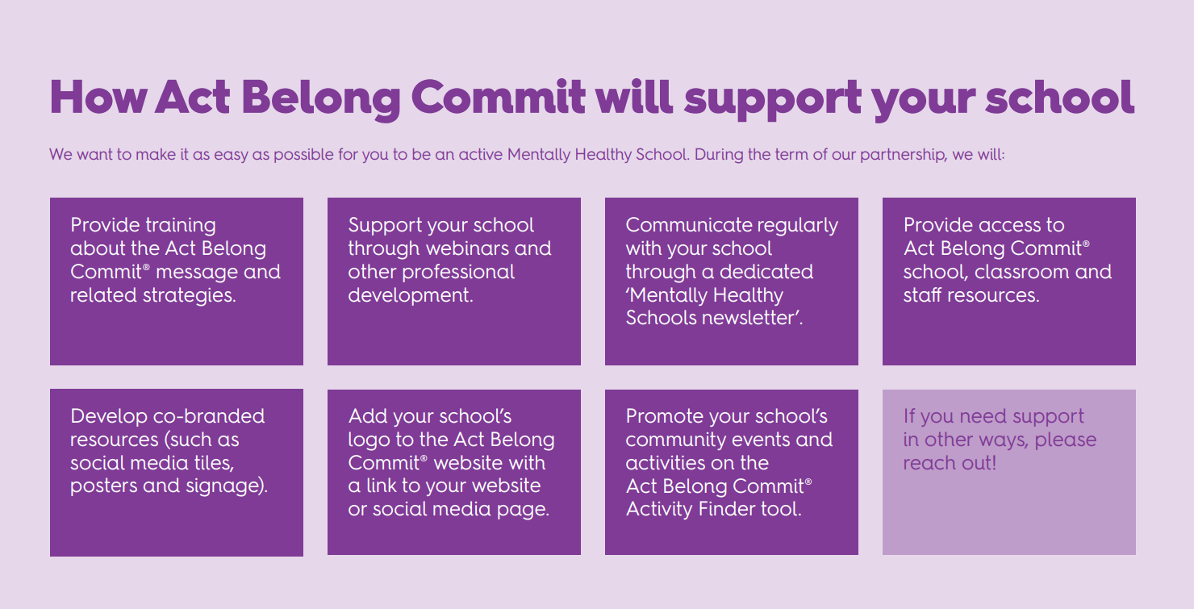

Slide 25
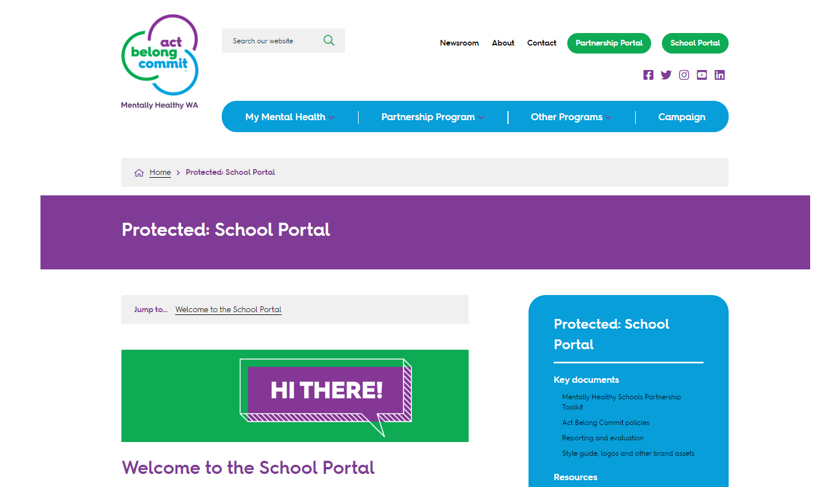

Slide 26

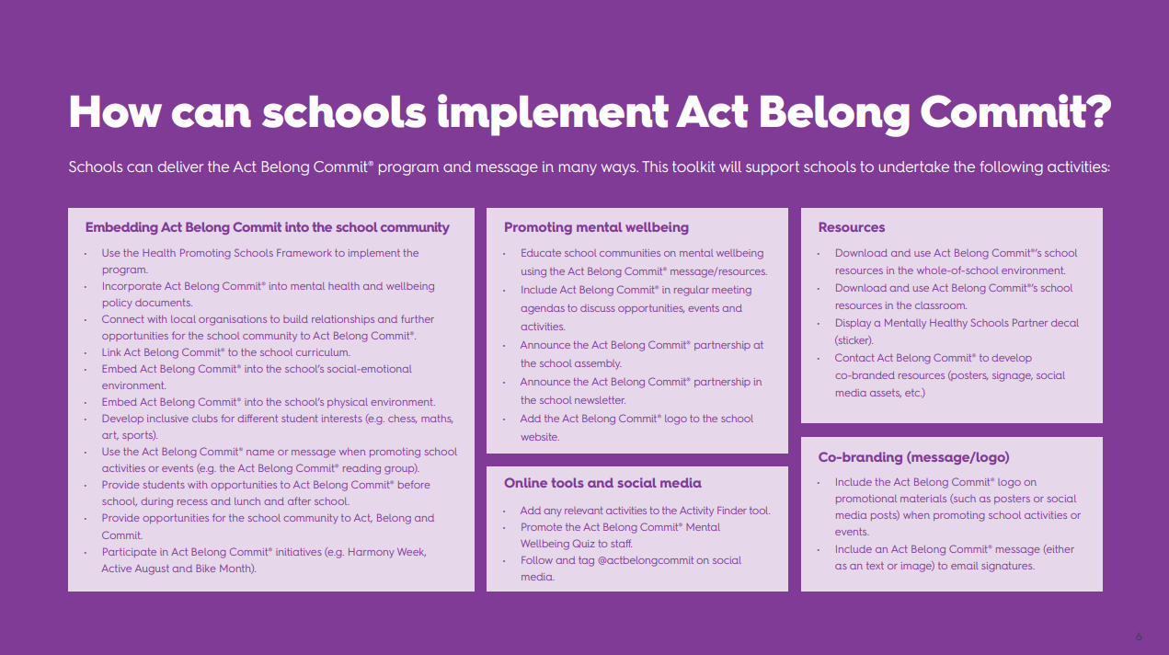

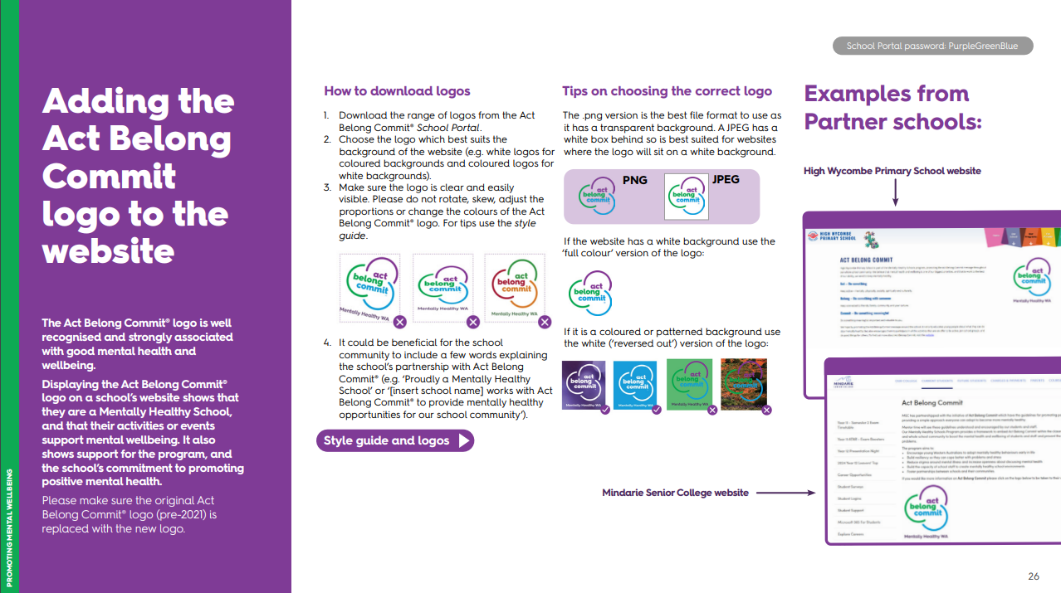

Slide 27
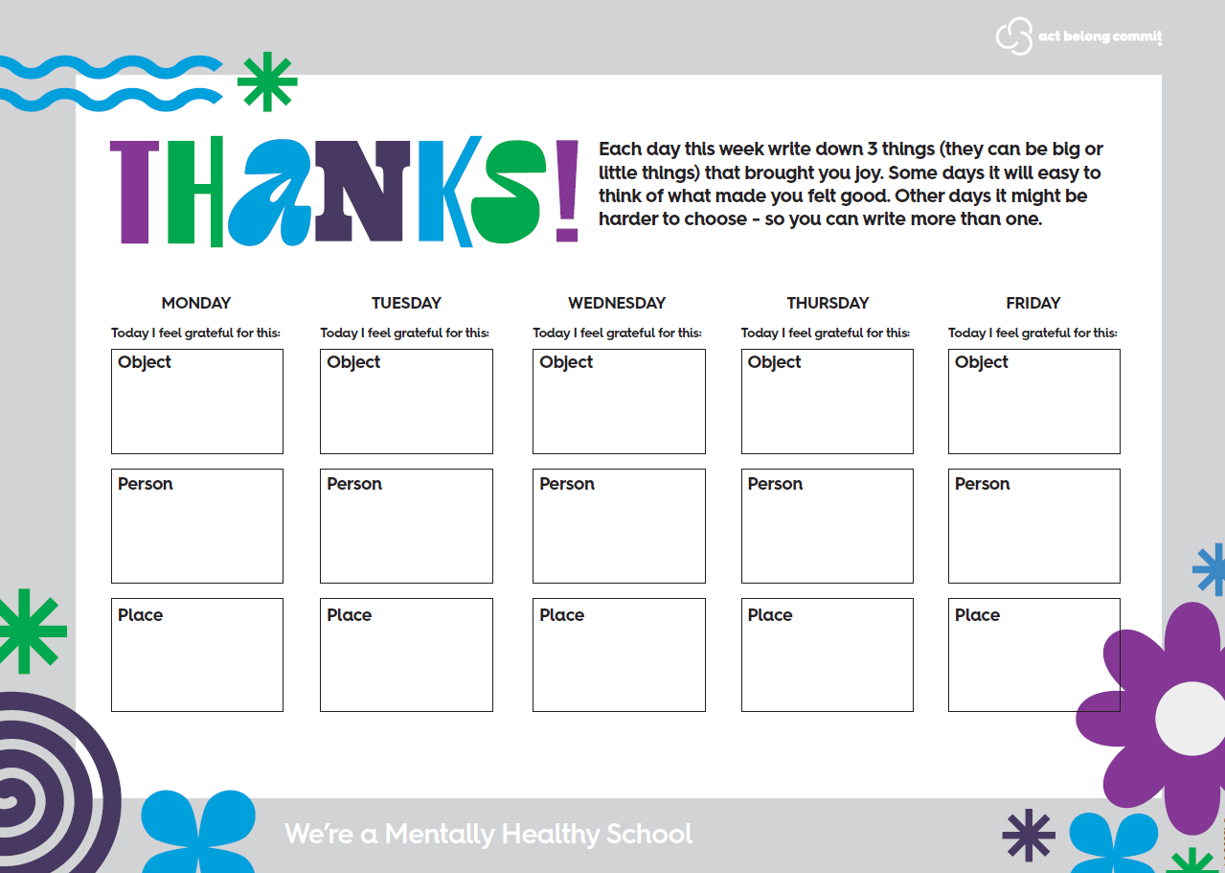
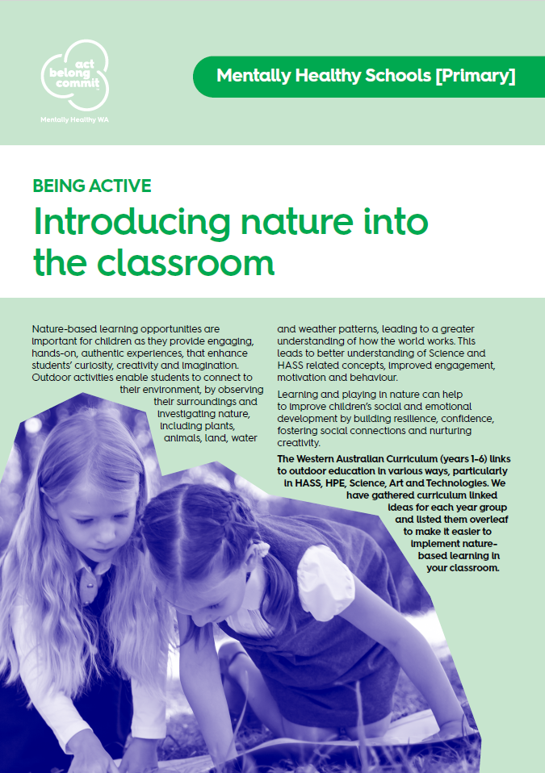




Increasing
message visibility
ACTIVITIES
POSTERS
EVIDENCE-BASED INFORMATION

Slide 28




Aboriginal resources
Keep mentally, socially, spiritually, physically and culturally active.
Build and maintain a strong Aboriginal and Torres Strait Islander identity by keeping connected to family and language groups, and by getting together with others at cultural events and visits to Country.
Commit to caring for Country, to teaching the young ones about culture and language or re-learning culture and language yourself, keep up obligations to family and community, take part in cultural ceremonies and express culture in art, music, dance or stories.

Slide 29



Increasing
message visibility
CO-BRANDED RESOURCES

Slide 30
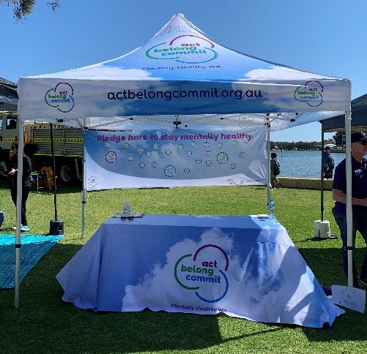



Signage
MARQUEES
BANNERS
CORFLUTE SIGNAGE

Slide 31

Can we create our own resources and projects?
YES!
We encourage you and your students to develop your own Act Belong Commit projects and resources.
We provide you with Act Belong Commit logos and style guide to use.

Slide 32
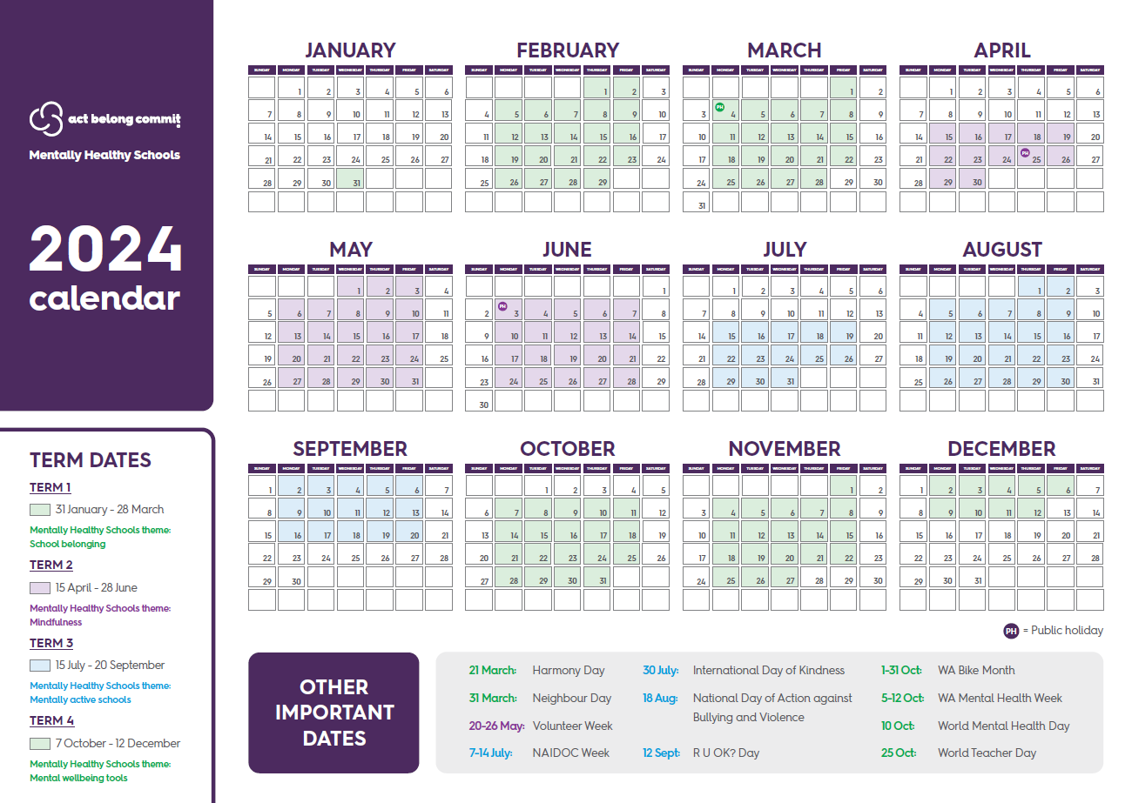
2024 Term Initiatives:
Term 1: Belonging
Term 2: Mindfulness
Term 3: Mentally active schools
Term 4: Mental wellbeing tools

Slide 33
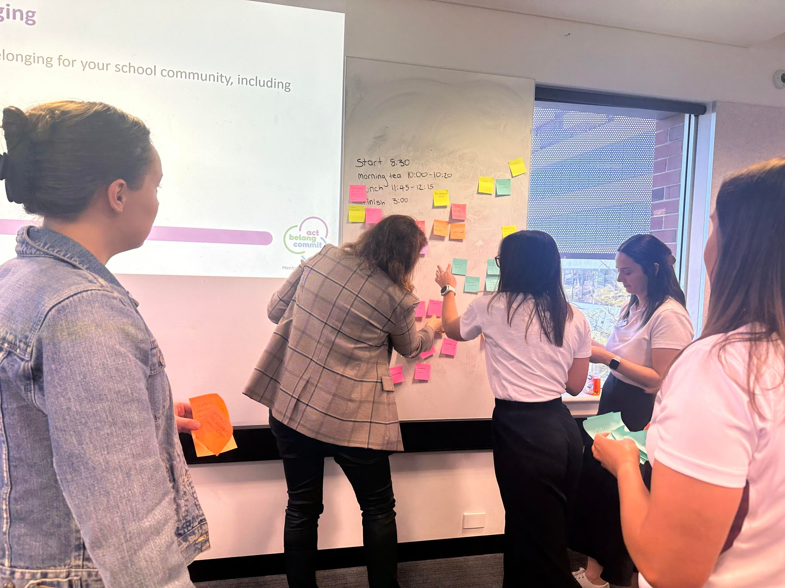
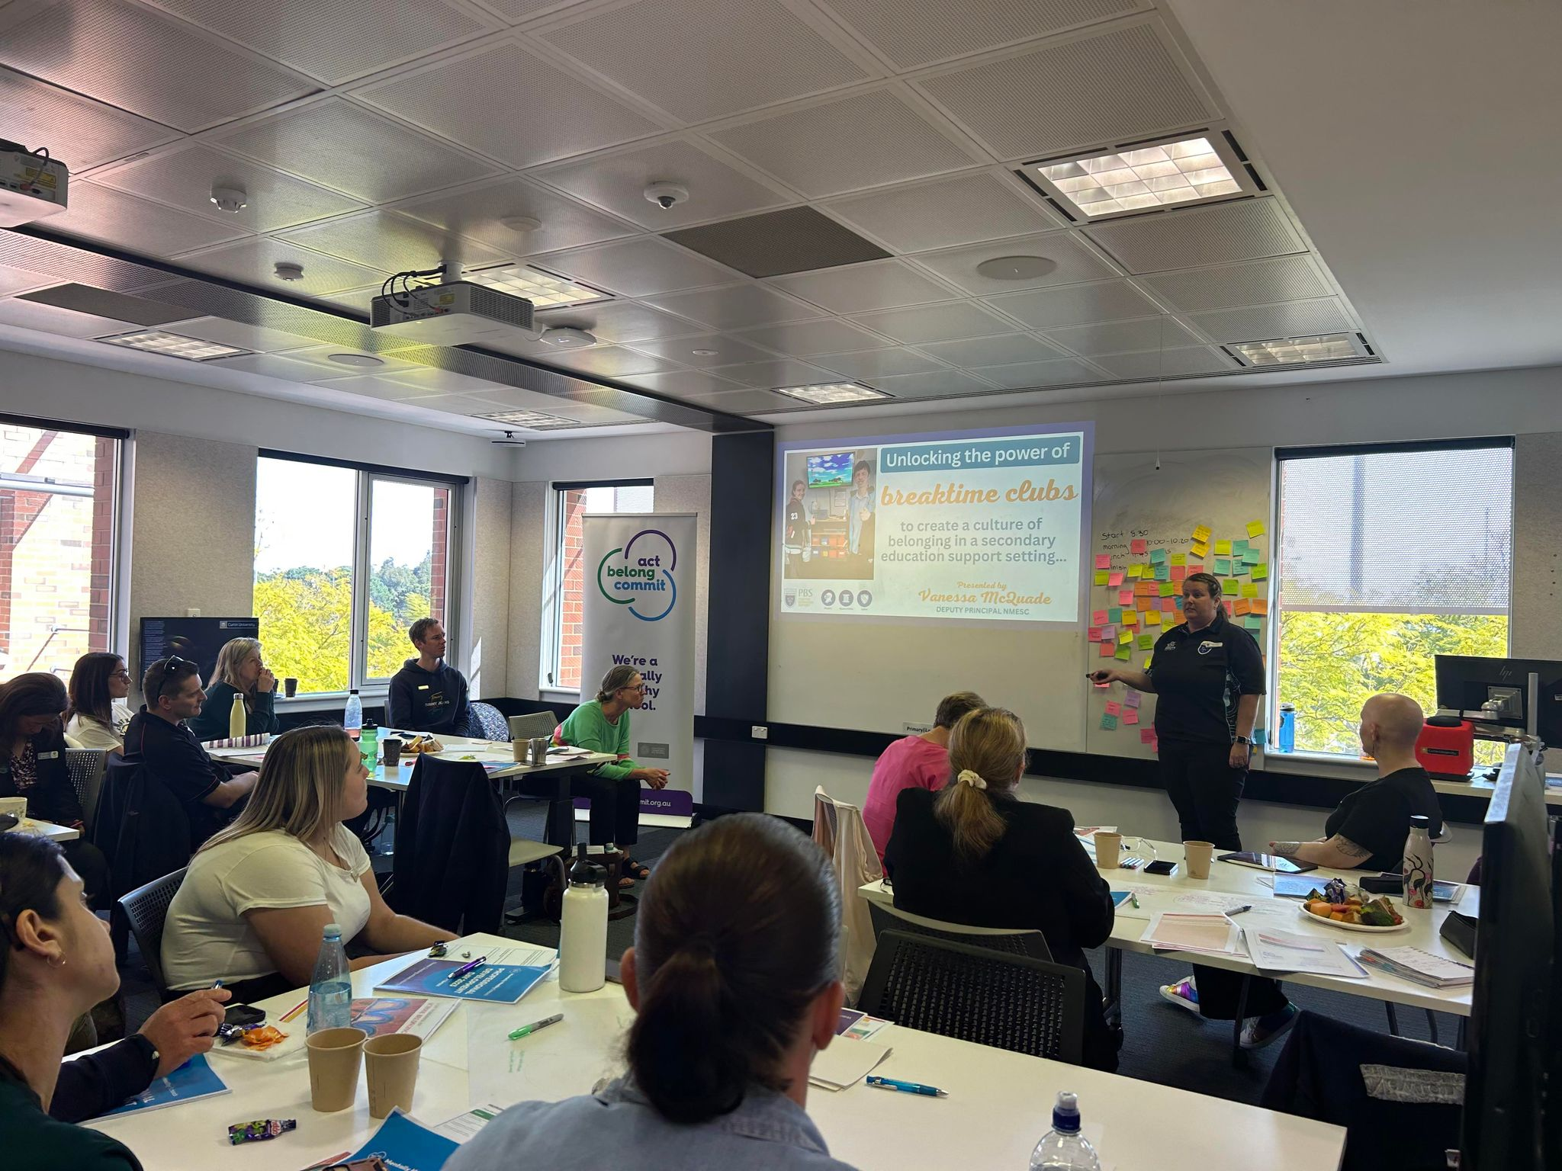
Annual Professional Development Day
2023: Creating School Belonging

Slide 34
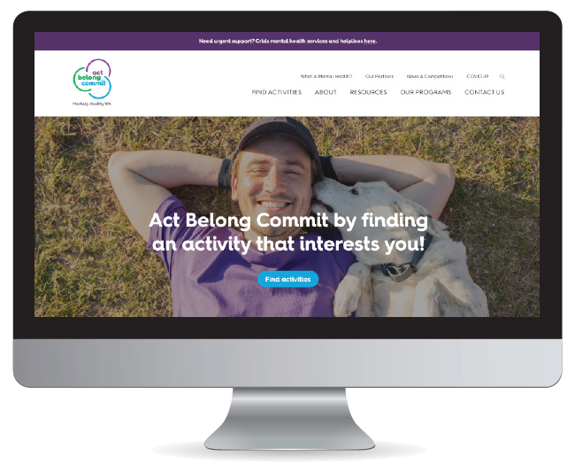
Website
Key tool of the campaign
Provides the ‘how’ and ‘tips’
Activity Finder
Providing opportunities for people across Western Australia to act, belong and commit with searchable ideas, clubs, organisations and events.

Slide 35
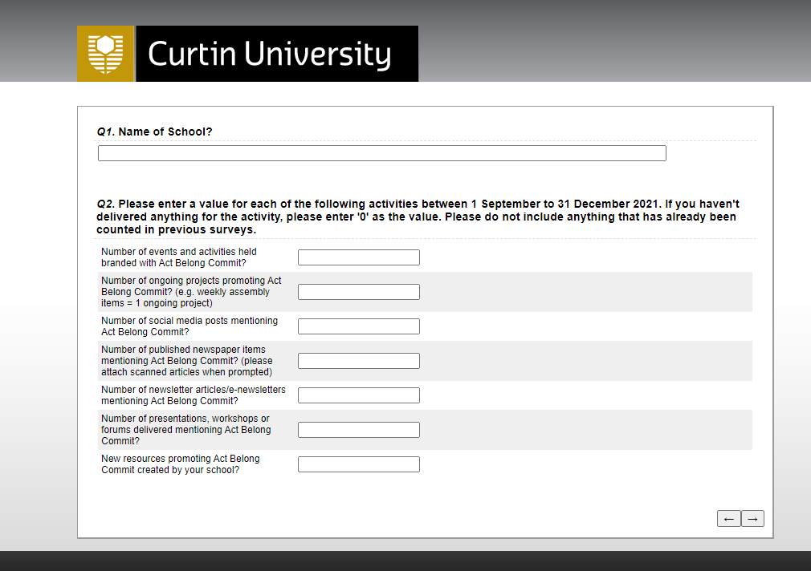
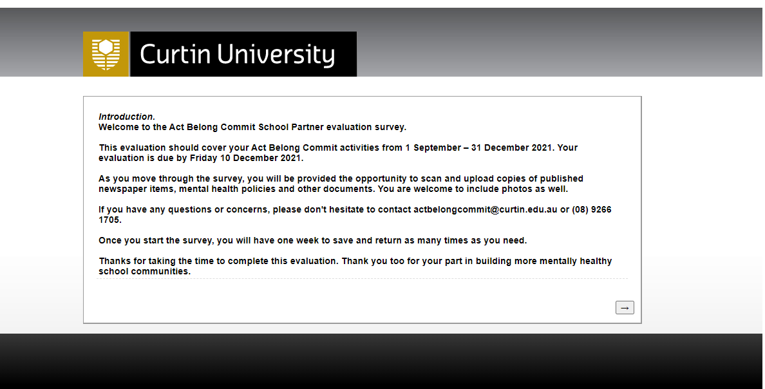
Evaluation

Slide 36
Getting Started
START HERE:
Log on to the School Portal, download and read through the Toolkit.
Announce the new partnership (assembly, newsletter and website).
Add the logo to school website.
Order/download paper-based resources, display posters around the school to raise awareness.
Plan some key activities and events for the next 12 months.
Add Act Belong Commit as a regular item on meeting agendas.
Request co-branded signage or posters (if applicable).
Utilise Act Belong Commit resources and teach the message in the classroom/whole school.
Incorporate Act Belong Commit in your school Wellbeing / Mental Health policies.

Slide 37
Questions?

Slide 38



Contact and Acknowledgements
Reearna Morgan
Mentally Healthy Schools Coordinator
Act Belong Commit Campaign
Mentally Healthy WA
P: (08) 9266 1873
E: Reearna.morgan@curtin.edu.au
W: actbelongcommit.org.au

